Slide 1
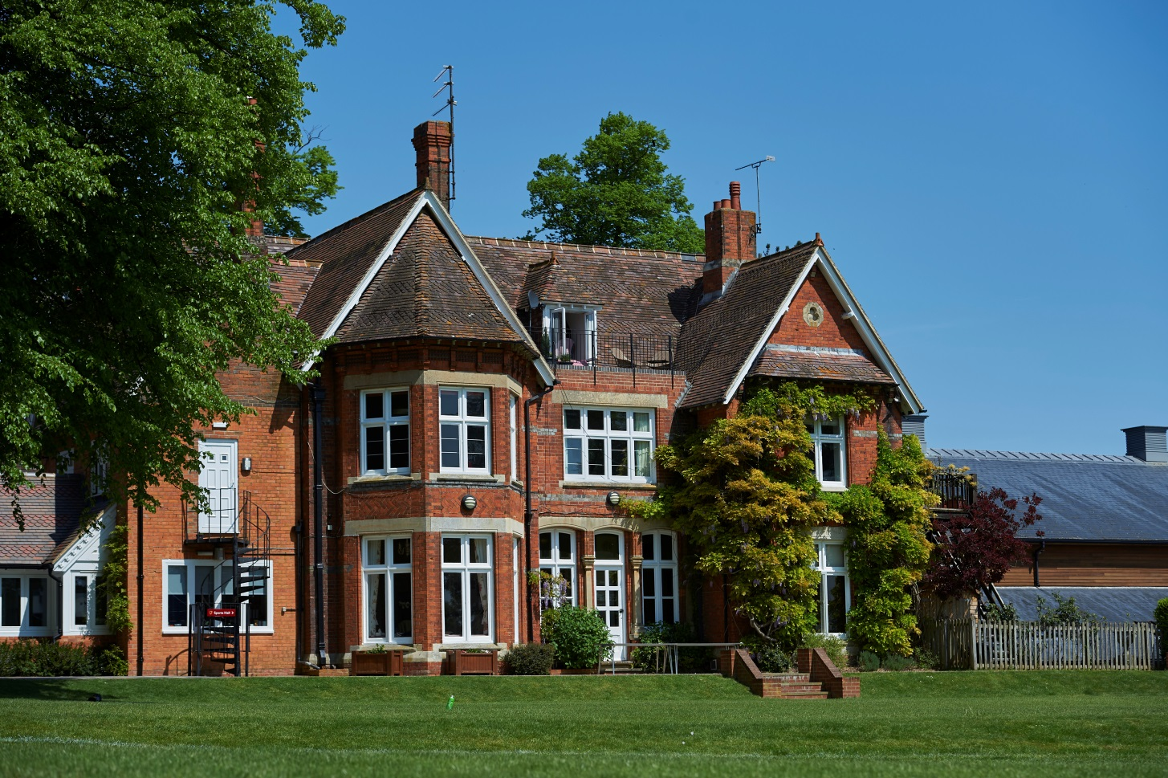
Boarding at Moulsford

Slide 2
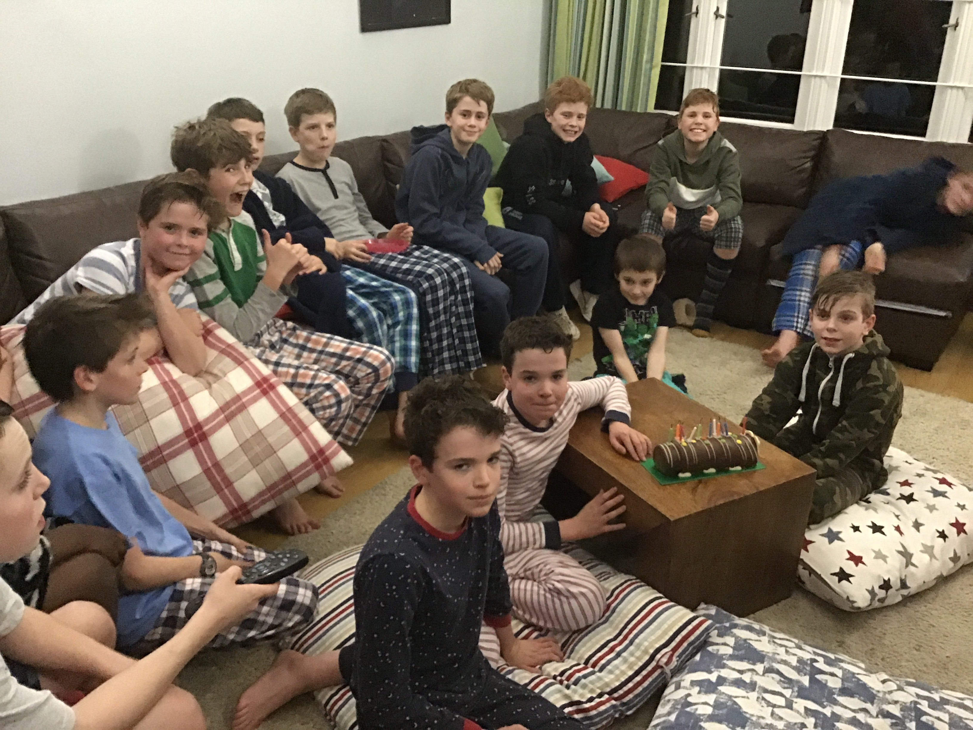
Why Board at Moulsford?
Facilities & Opportunities
Academic Help & Structure
Social Aspect
Experience
Skills
Fun!!

Slide 3
What Do We Offer?
Weekly Boarding – 4 nights: Monday, Tuesday, Wednesday, Thursday.
Flexi-boarding – 2 nights: Either Monday & Tuesday, or Wednesday & Thursday.
Day Boarding – Typically either Monday or Tuesday, but can be Wednesday or Thursday. Boys join boarding activities and routine from 5.45pm until collection at 8.00pm. N/A at present.
Trial Boarding – available throughout the Autumn and Spring terms, and potentially in the Summer Term, depending on space.

Slide 4
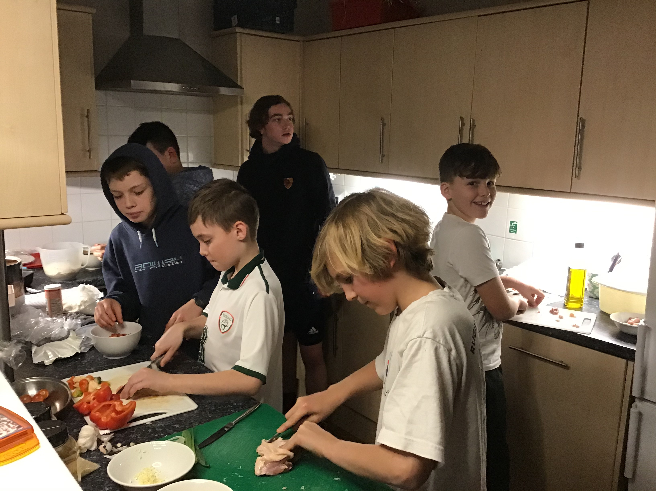
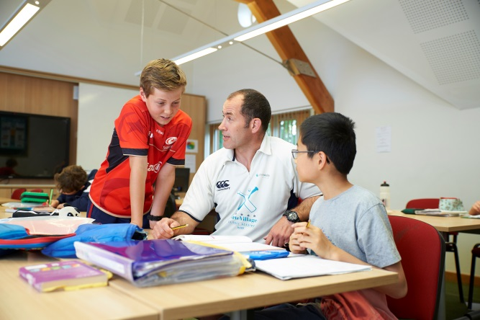
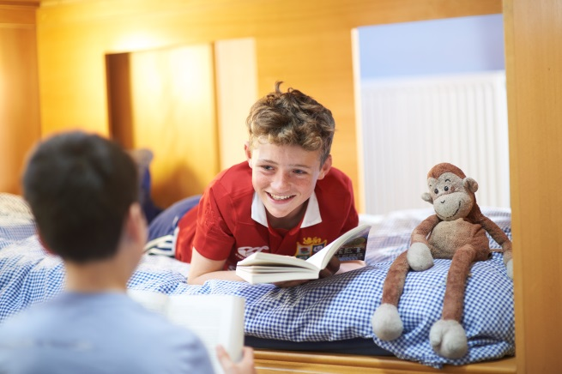
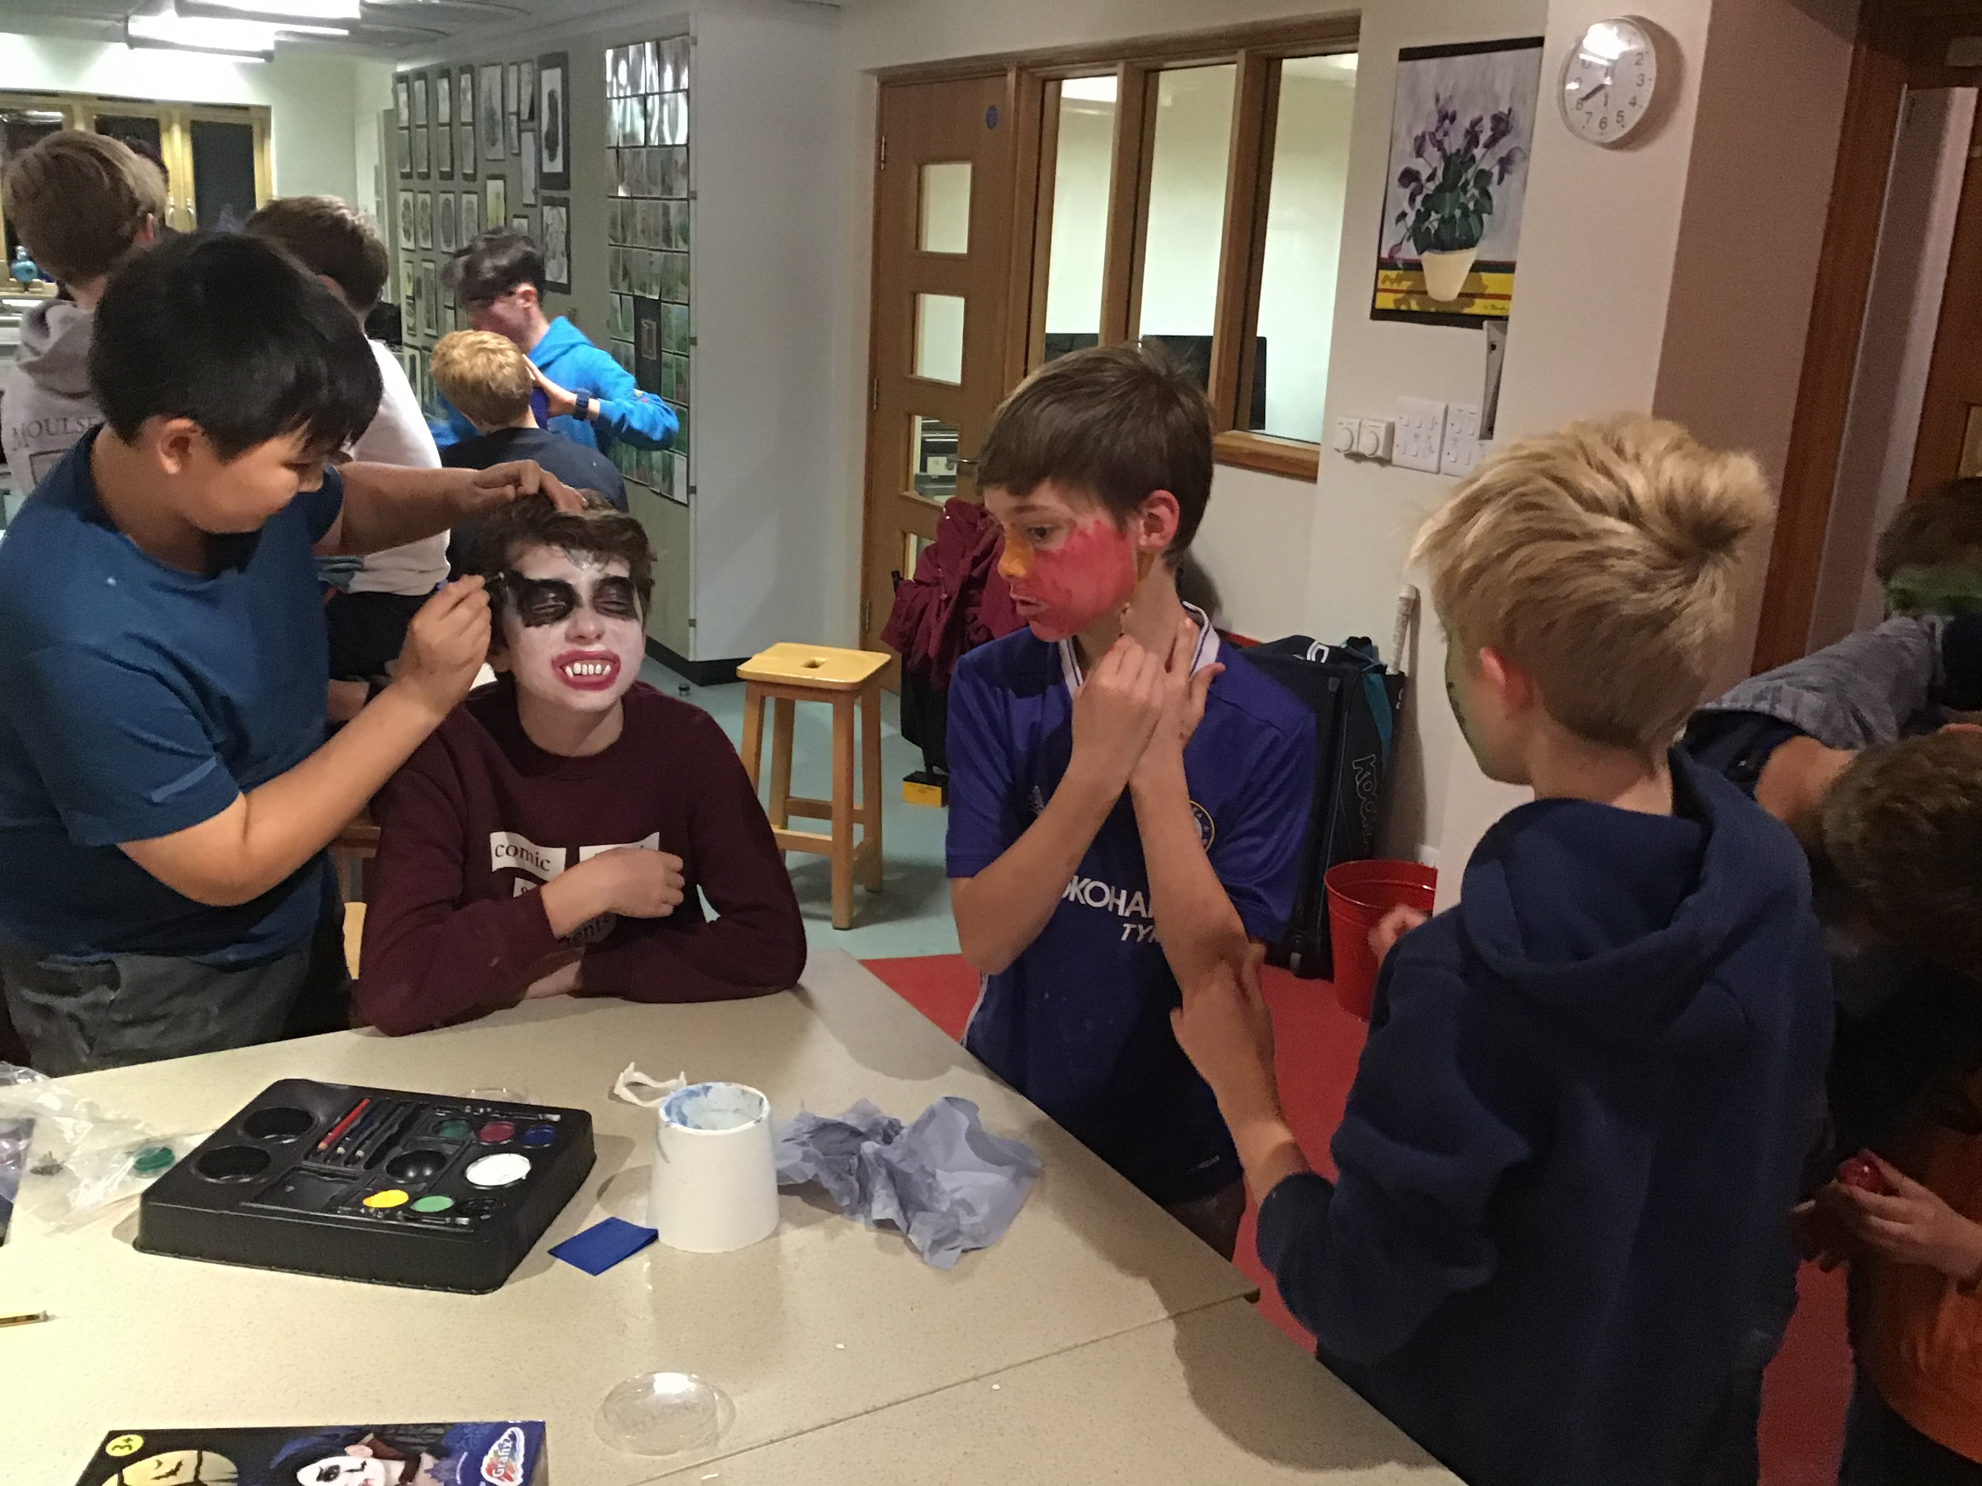
A Day in The Life of a Moulsford Boarder

Slide 5
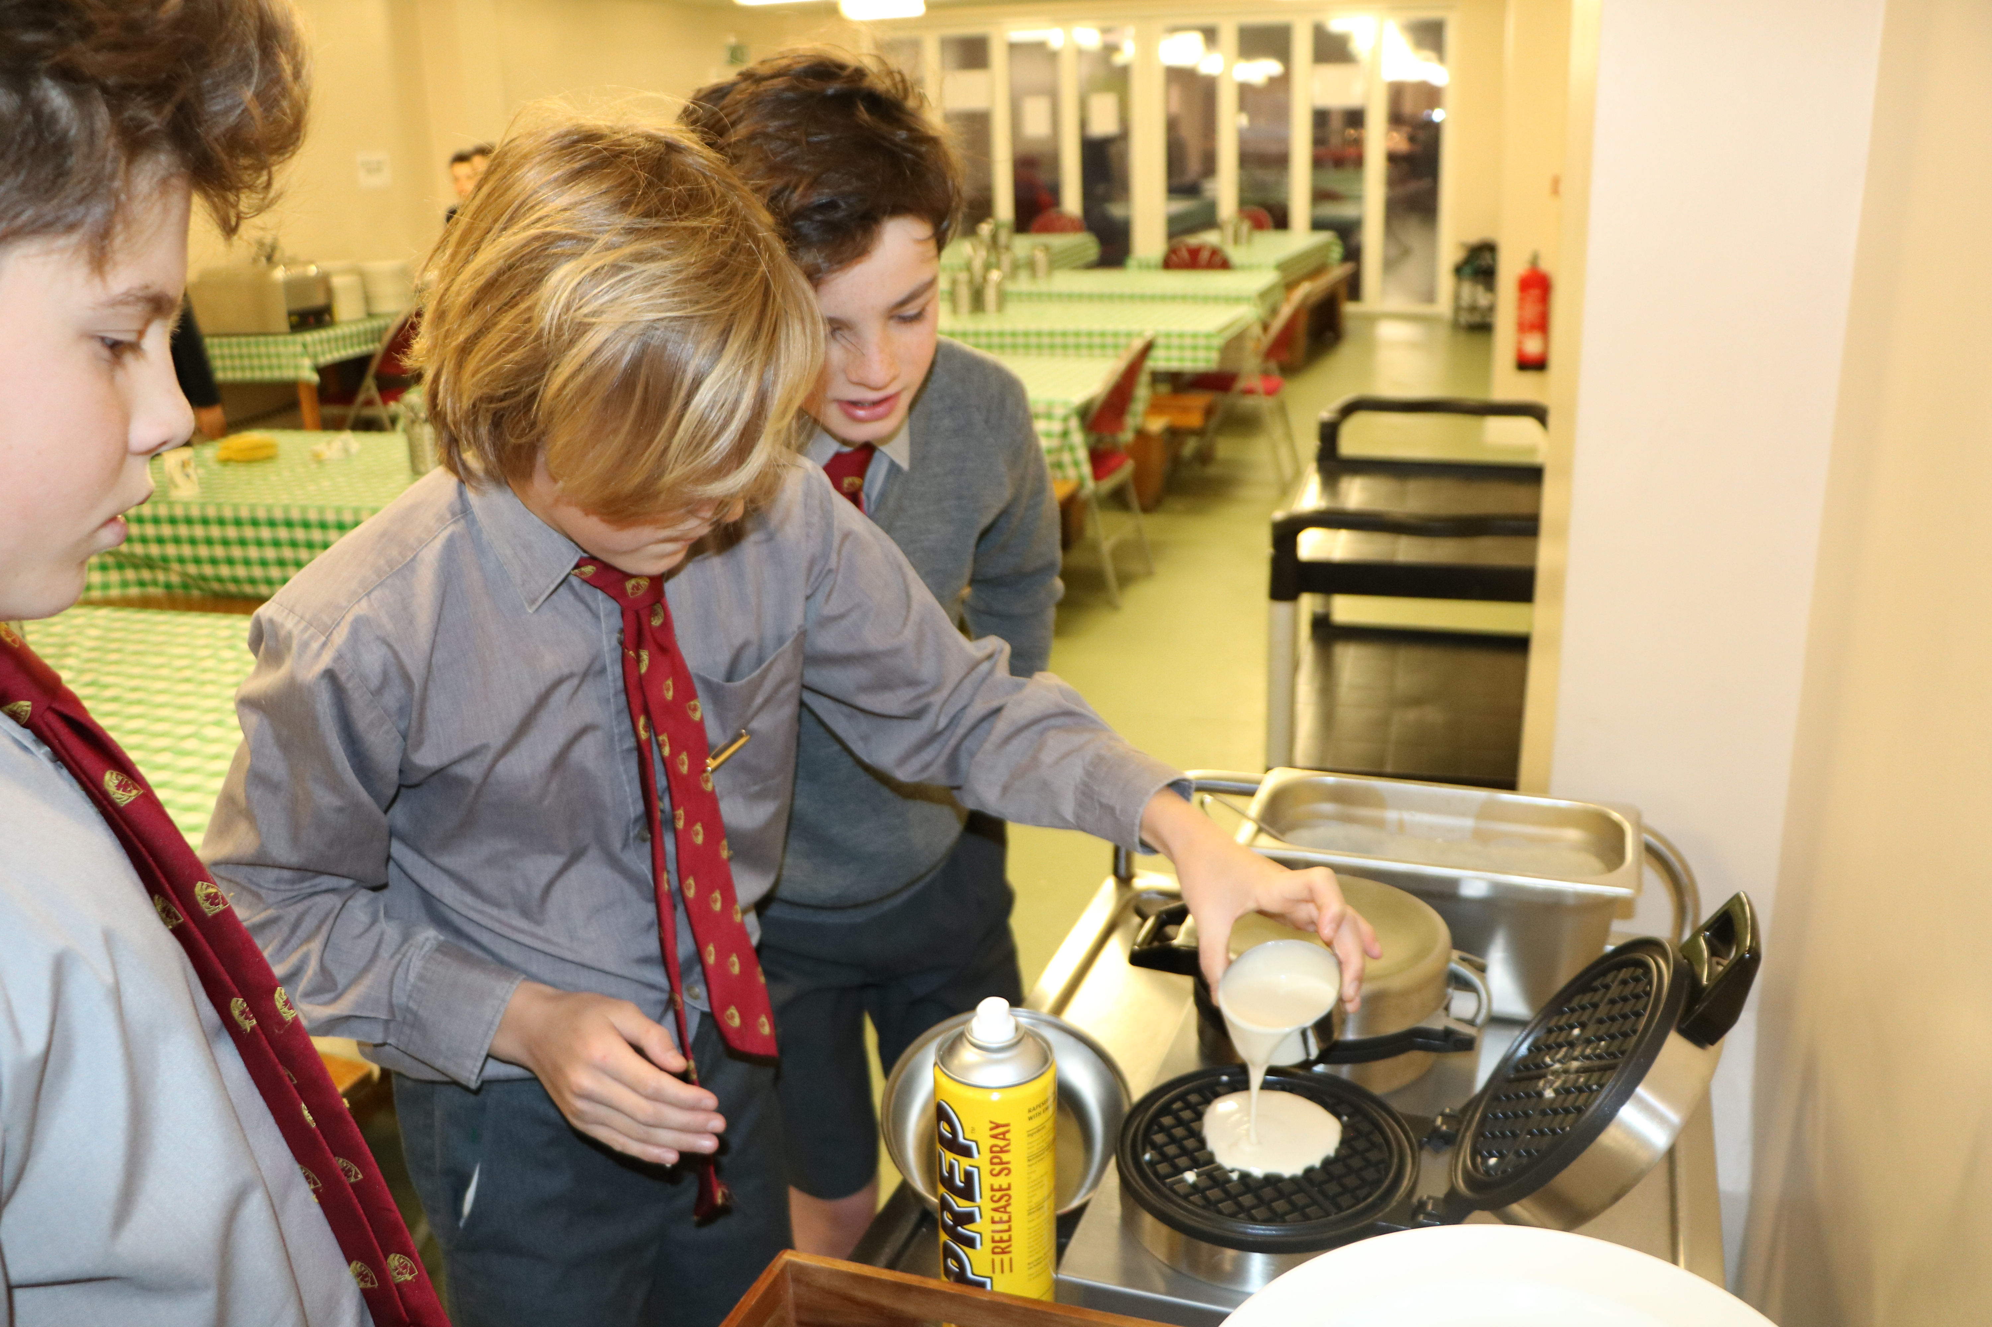
7.15am Wake Up & 7.40am Breakfast

Slide 6
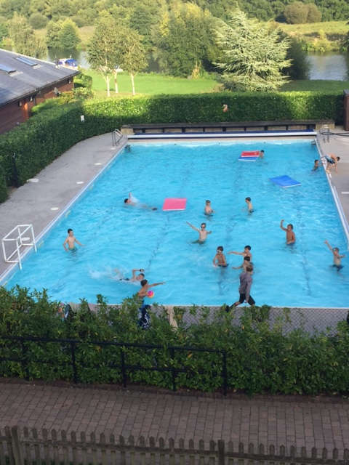
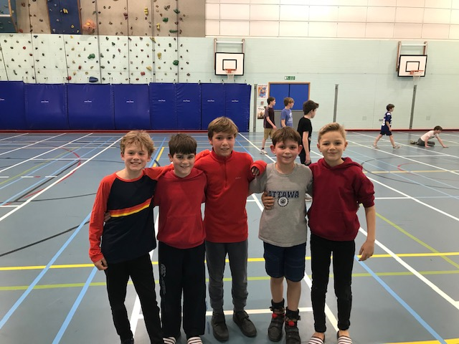
5.45pm to 6.15pm – Free Time / Activities

Slide 7
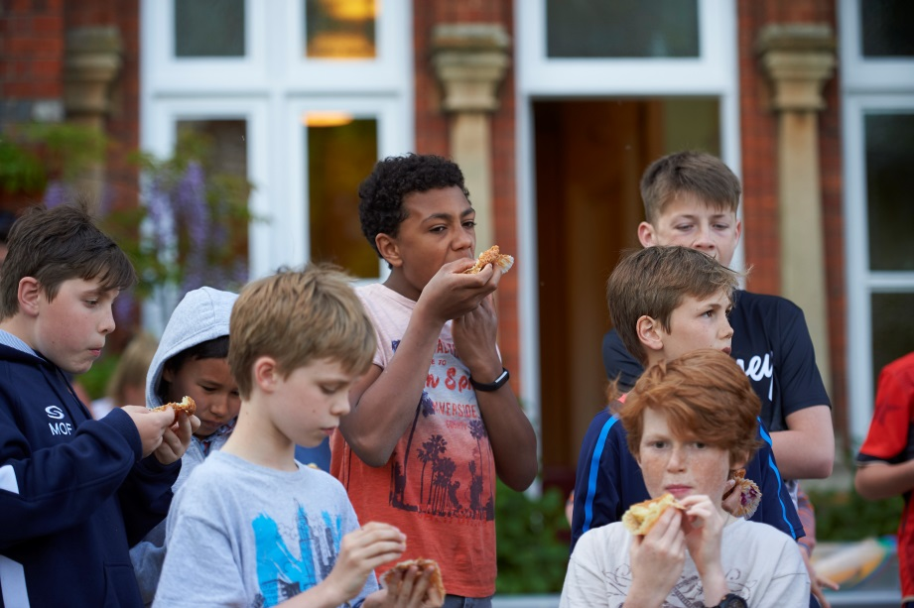
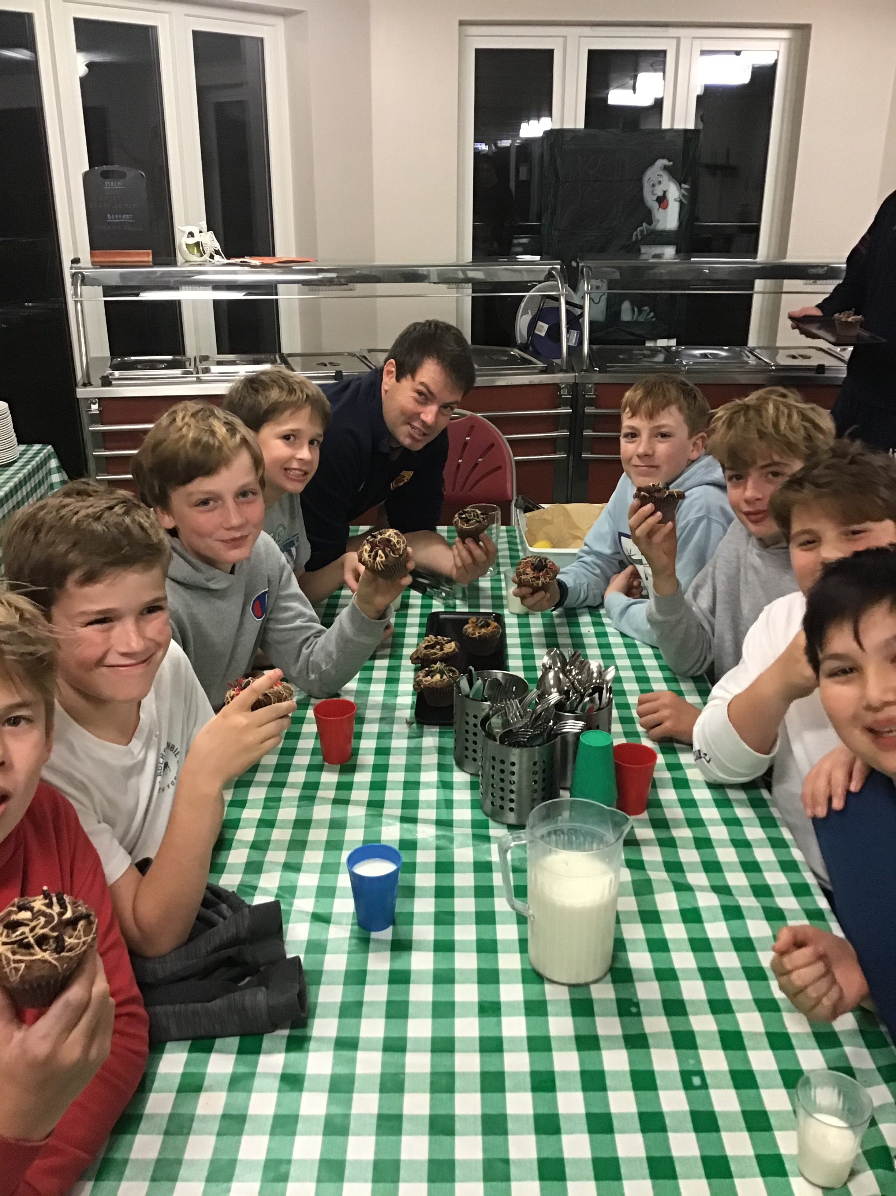
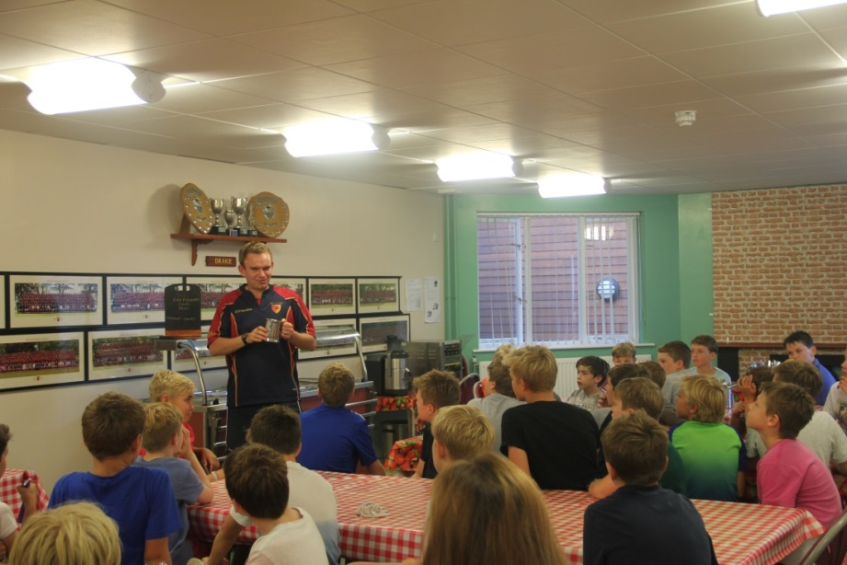
6.15pm – Supper Time

Slide 8
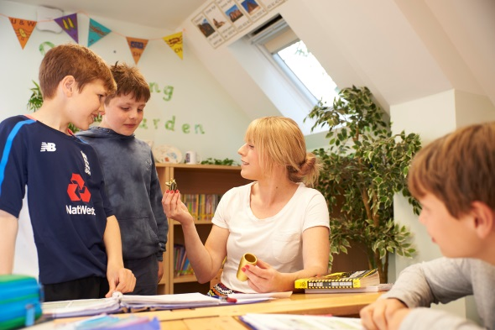
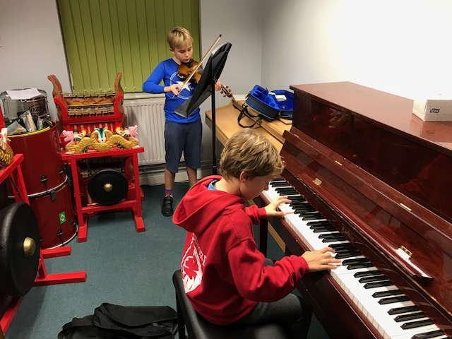
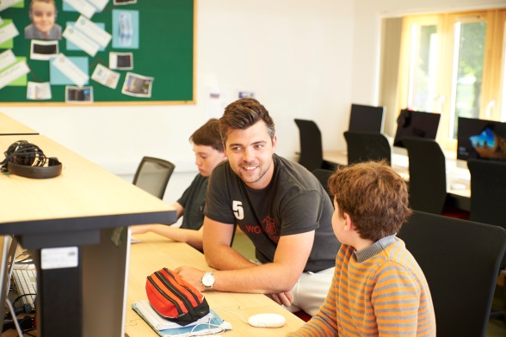
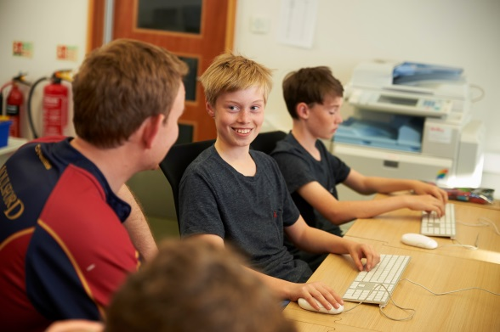
6.45pm – Extra Work & Music Practice

Slide 9
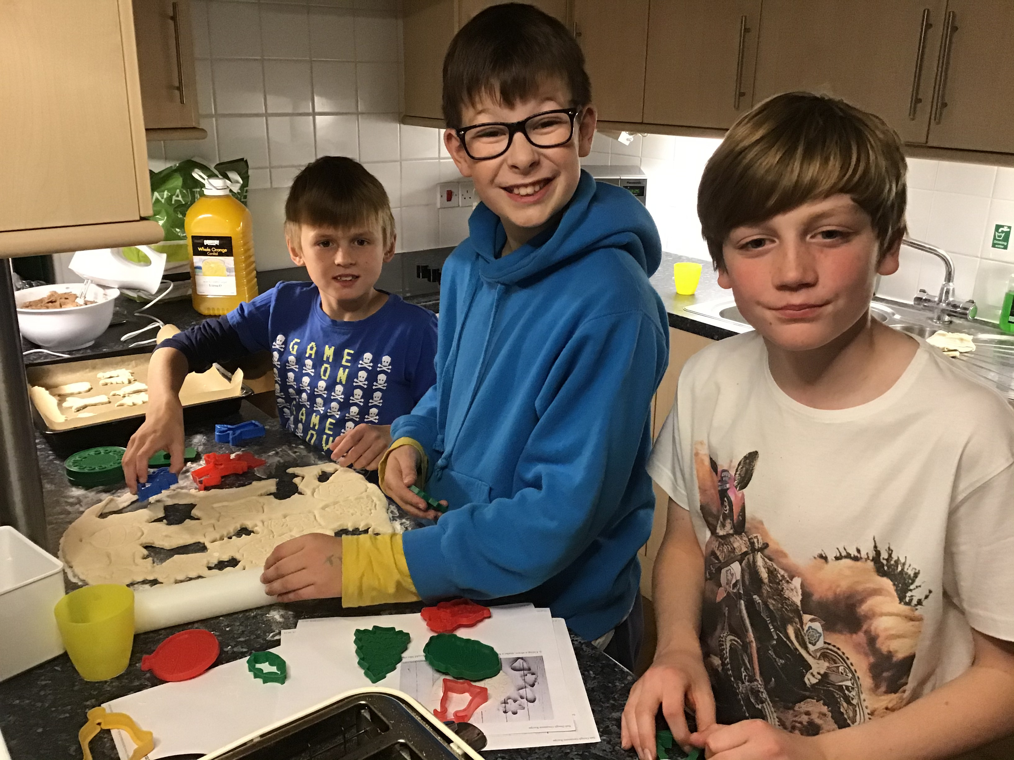
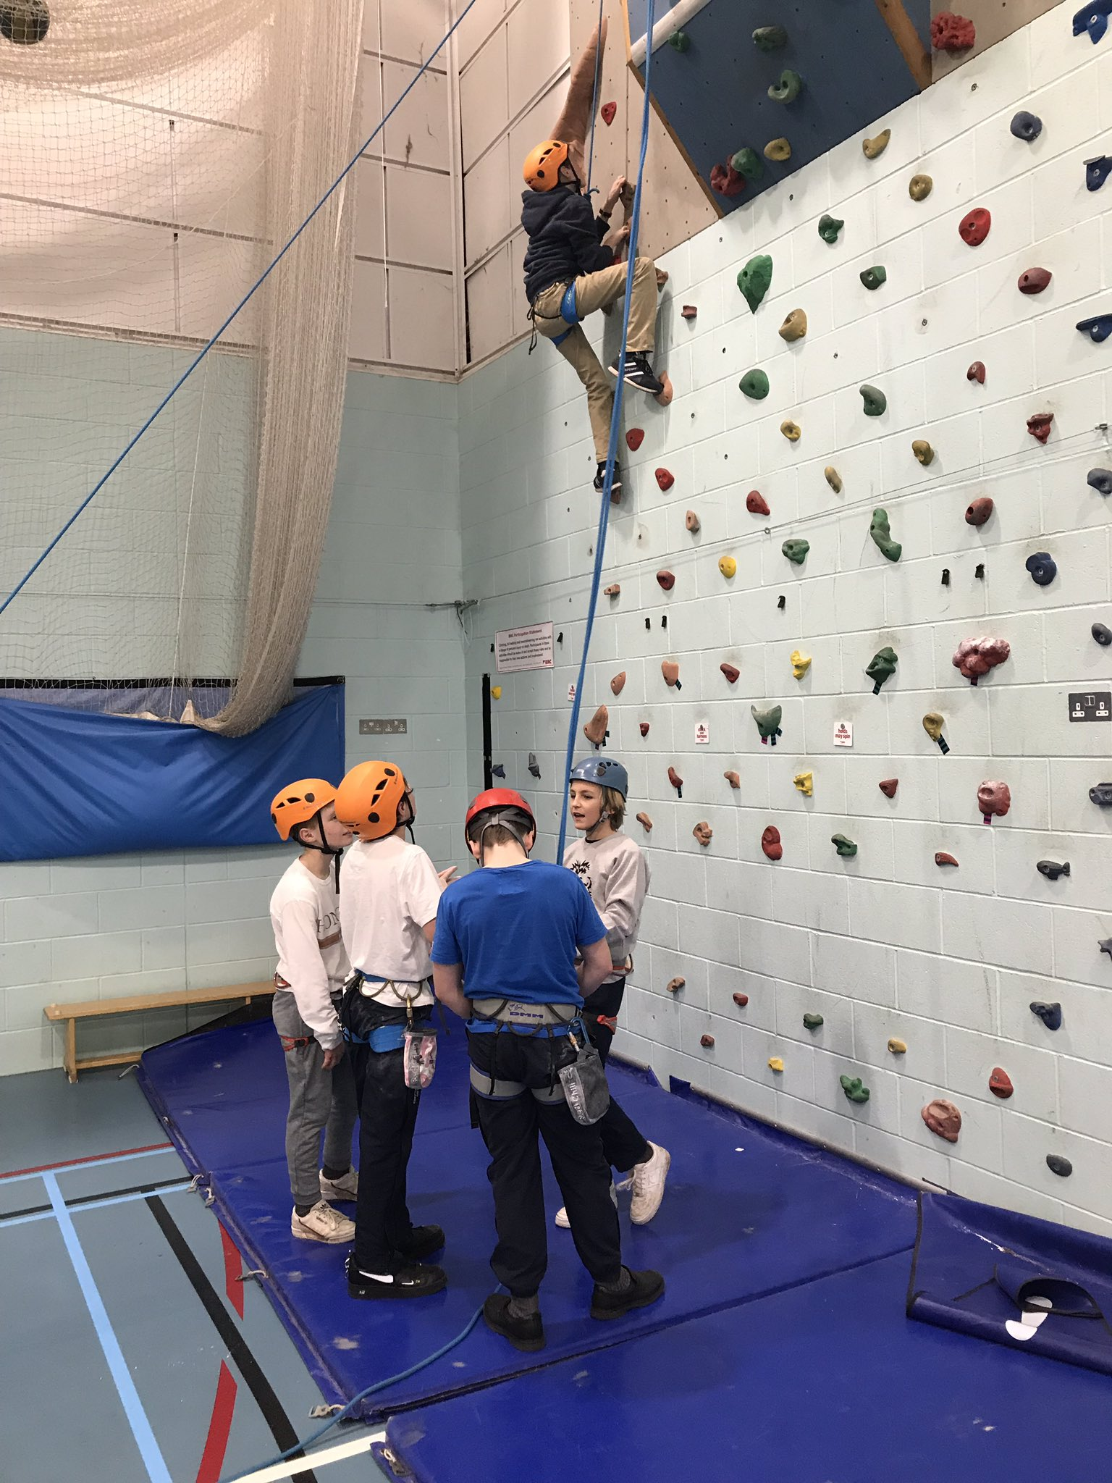
7.15pm/7.30pm – Free Time / Activities

Slide 10
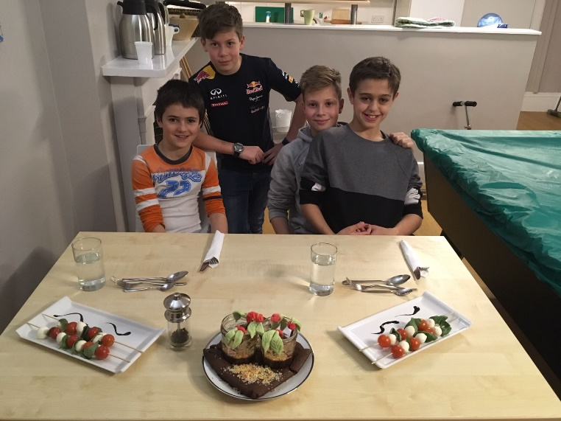
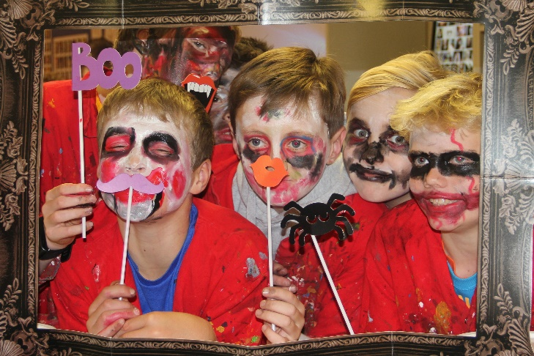
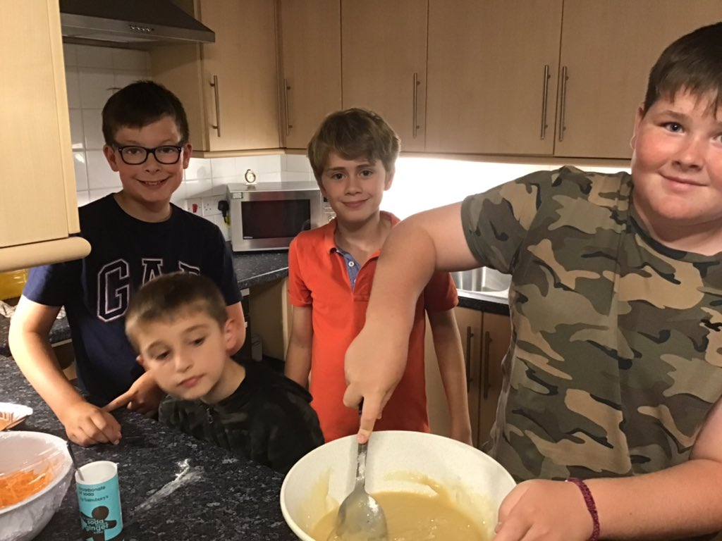
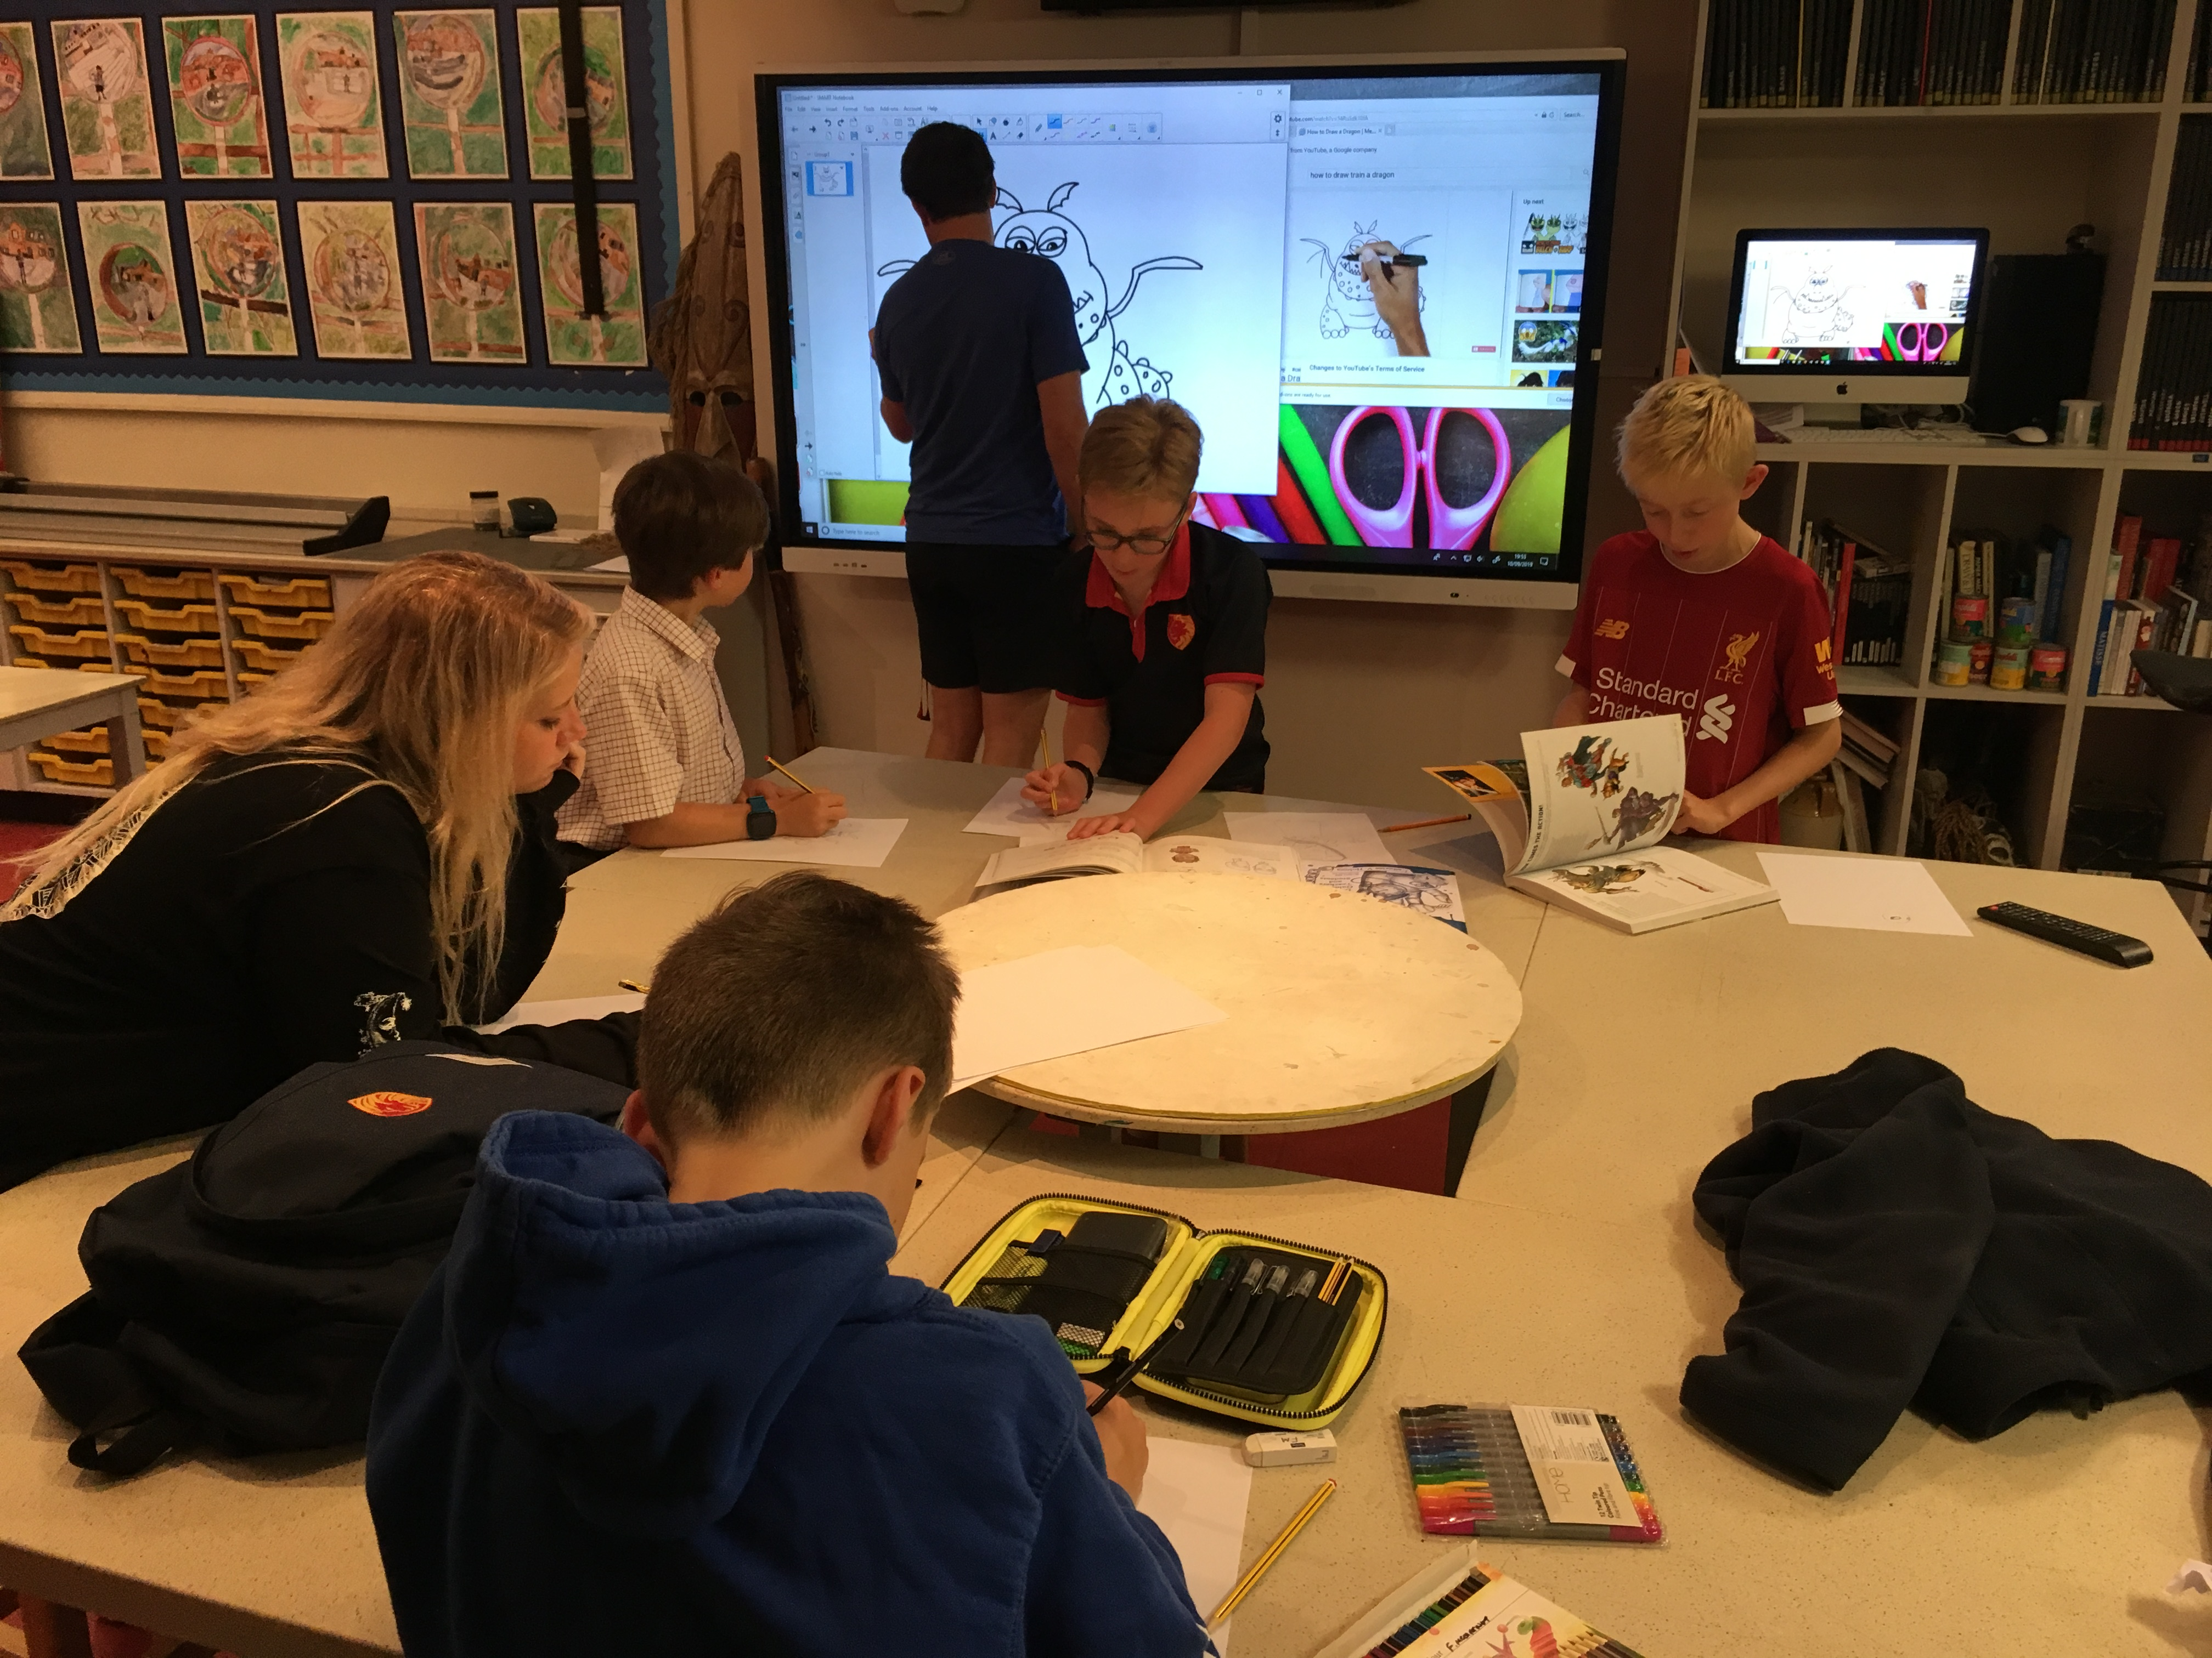
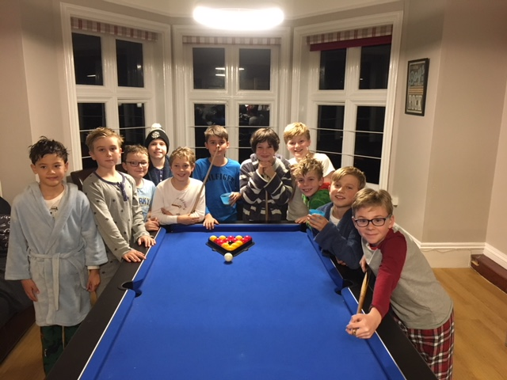
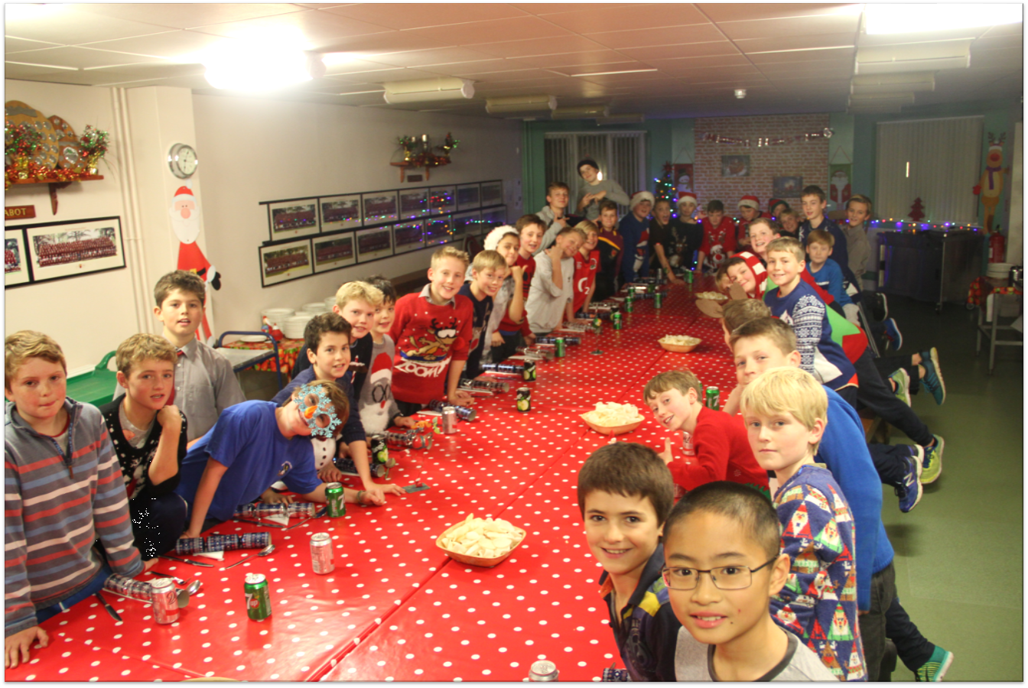

Slide 11
Bed Time – Age Dependent

Slide 12
What the boys think…
‘I get my work done’
‘I enjoy mixing with different ages and friends’
‘The endless possibilities’
‘There is so much to do’
‘I love the food’
‘I love the homeliness’
‘It is like a second home’
‘Caring environment’
‘I enjoy the opportunities to make my own decisions’

